Slide 1

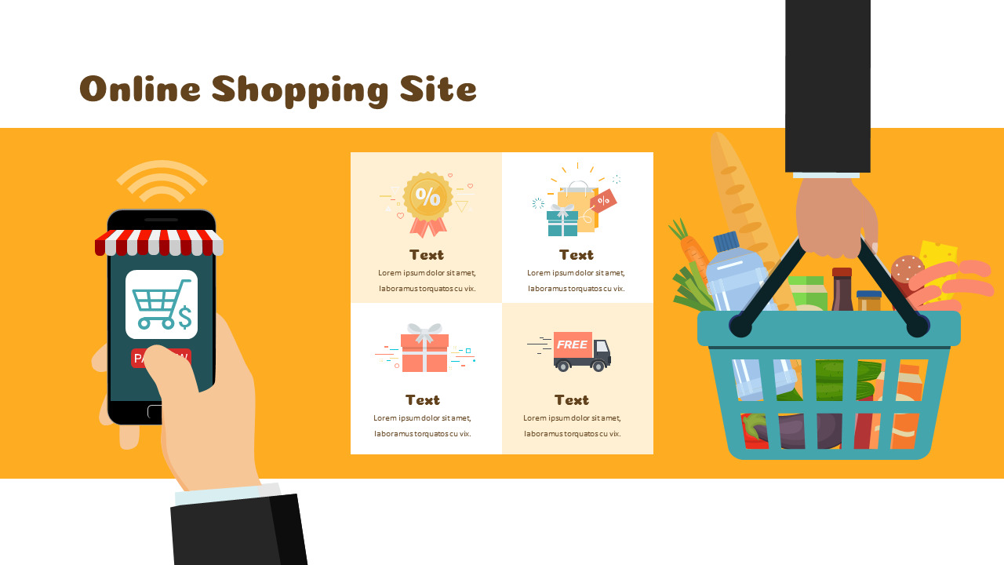
ONLINE GROCERY
SHOPPING
SUBMITTED BY :
1. | Aman Kumar Jha | 20BCS5513

Slide 2
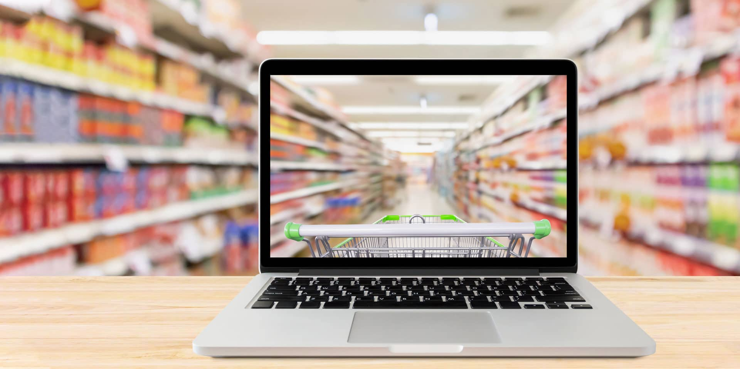
CONTENTS
Introduction
Proposed System
Objective
Application Tools Used : || Front End
|| Back End
Flow Chart
Screenshots
Advantages Of The Proposed System
Scope Of The Proposed System
Conclusion

Slide 3

INTRODUCTION
Online Grocery Market is a form of ecommerce that allows consumers to directly buy fresh food stuffs or produce from a seller over the Internet.
The proposed system is a website that will collect information about customers who wish to buy or check prices of items from the market.

Slide 4
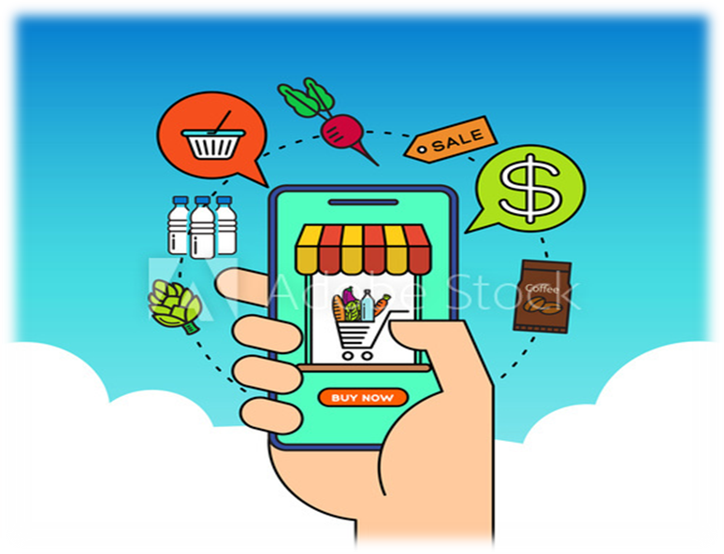
PROPOSED SYSTEM
The website is proposed to be an extension of the market to customers who find it difficult to arrive at the markets.
This system is geared at easing the shopping stress of most customers who have to hustle from shed to shed in the scorching sun just to find fresh food stuff in the crowded market and specially for people suffering from PANDEMIC.

Slide 5
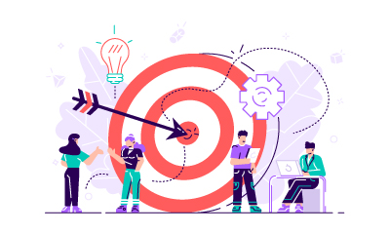
OBJECTIVE
The aim of this proposed system is to expand the profit making possibility of sellers in market and give customers the chance to freely buy food stuffs over the internet without stepping a foot in the market.

Slide 6

APPLICATION TOOLS
USED :
A programming tool or software development tool is a compute program that software developer use to create, debug, maintain, or otherwise support other programs and applications.

Slide 7

FRONT END
Tim Berners-Lee specified HTML and wrote the browser and server software in late 1990.
The Hyper Text Markup Language, or HTML is the standard markup language for documents designed to be displayed in a web browser.

Slide 8
FRONT END
Cascading Style Sheets (CSS) is a style sheet language.
It used for describing the presentation of a document written in a markup language such as HTML.

Slide 9
FRONT END
As a multi-paradigm language, JavaScript supports functional, and imperative programming styles.
JavaScript is high-level, often just-in-time compiled, and multi-paradigm.

Slide 10

BACK END
SQL is a domain-specific language used in programming and designed for managing data held in a relational database management system (RDBMS).
SQL stands for Structured Query Language.

Slide 11

BACK END
PHP stands for “Hypertext Preprocessor“. PHP is a widely-used, open source scripting language.
It was originally created by Danish-Canadian programmer Rasmus Lerdorf in 1994.

Slide 12
NAVIGATIONAL STRUCTURE
HOME
Main.html
CATEGORY
Index.html
PRODUCT
DEAL
CONTACT
TOP LEVELS OF THE WEBSITE

Slide 13
NAVIGATIONAL STRUCTURE
Main.html
Index.html
CART
Login.html
Cart.html
ADD TO CART & LOGIN SECTION

Slide 14
NAVIGATIONAL LINKS IN CATEGORY SECTION
Fruits.html
Vegetables.html
Meat.html
Covid-19.html
Dairy-Product.html
Kitchen Accessories.html
Category
Cleaning-Products.html

Slide 15

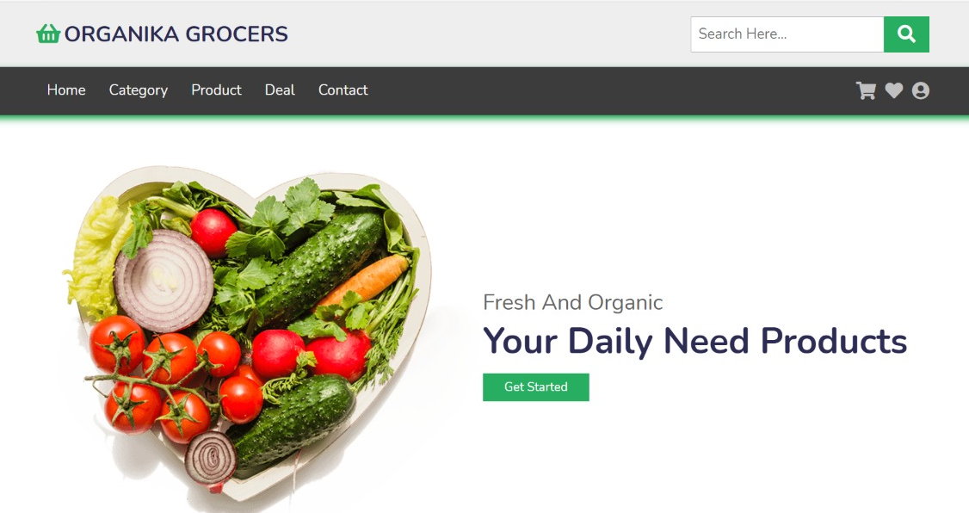
HOME PAGE

Slide 16
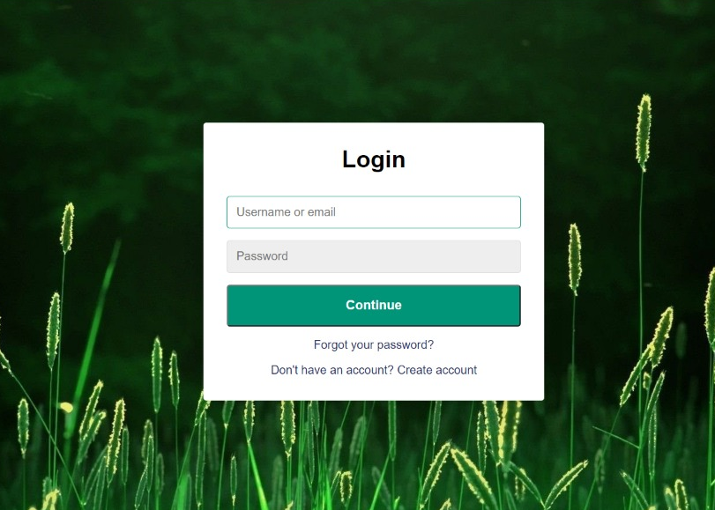
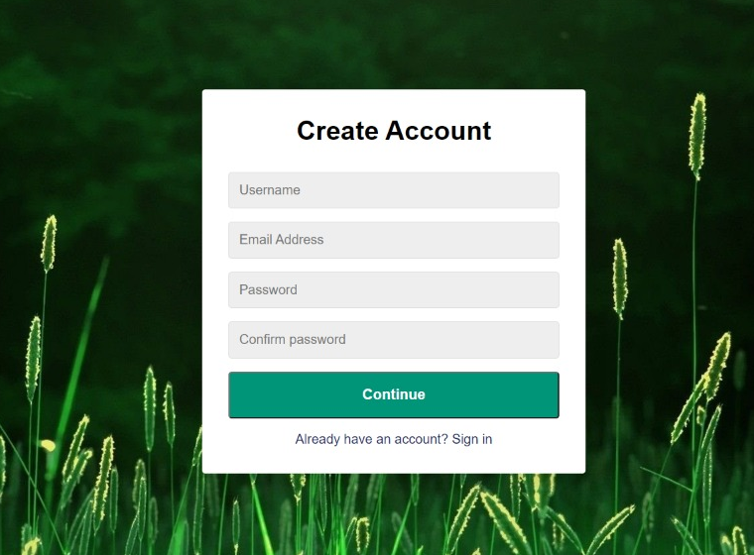
LOGIN PAGE

Slide 17
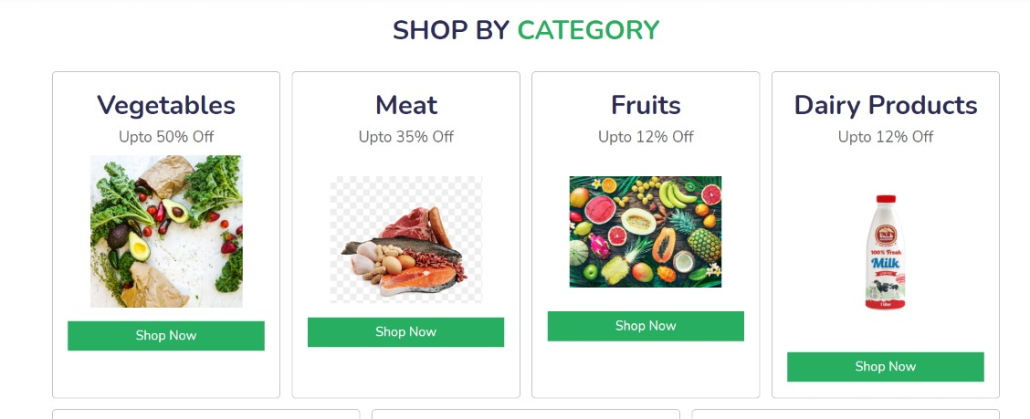
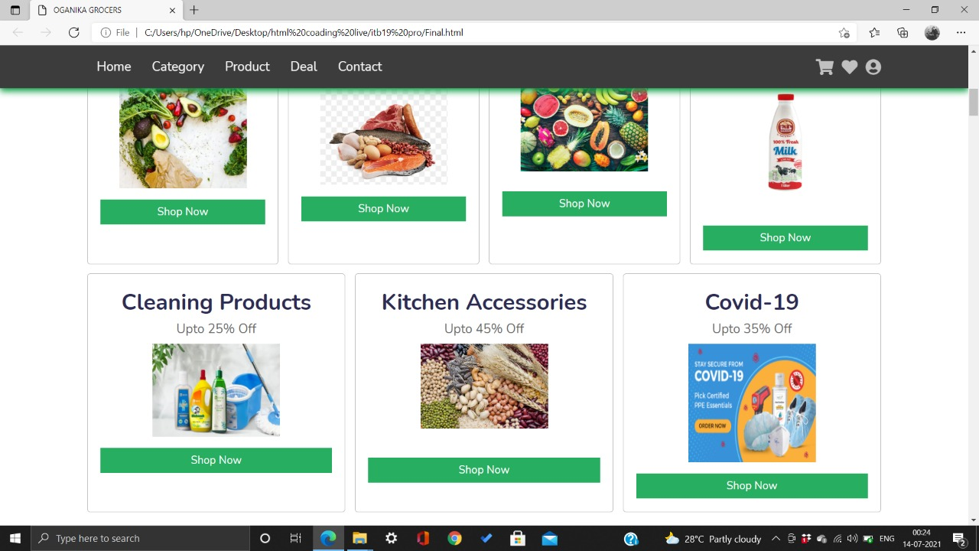
CATEGORY SECTION

Slide 18
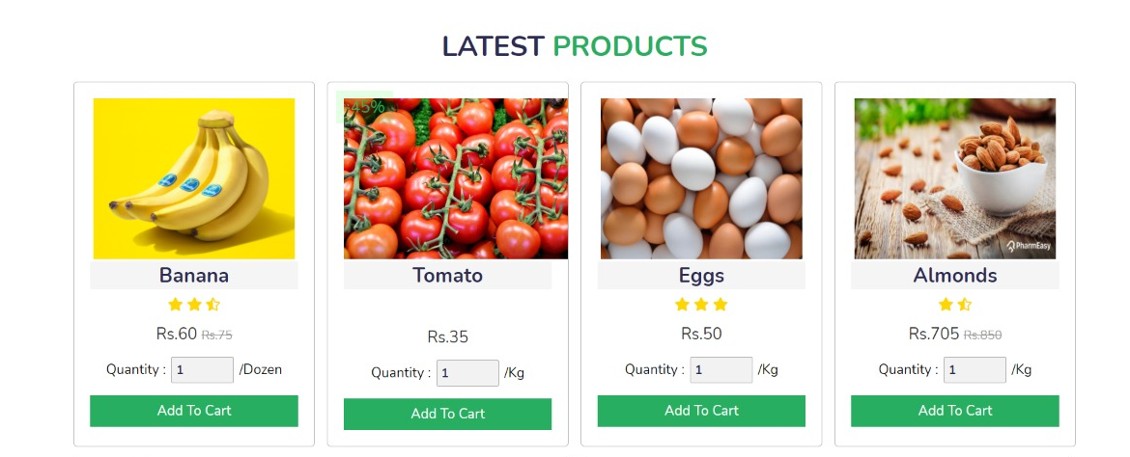
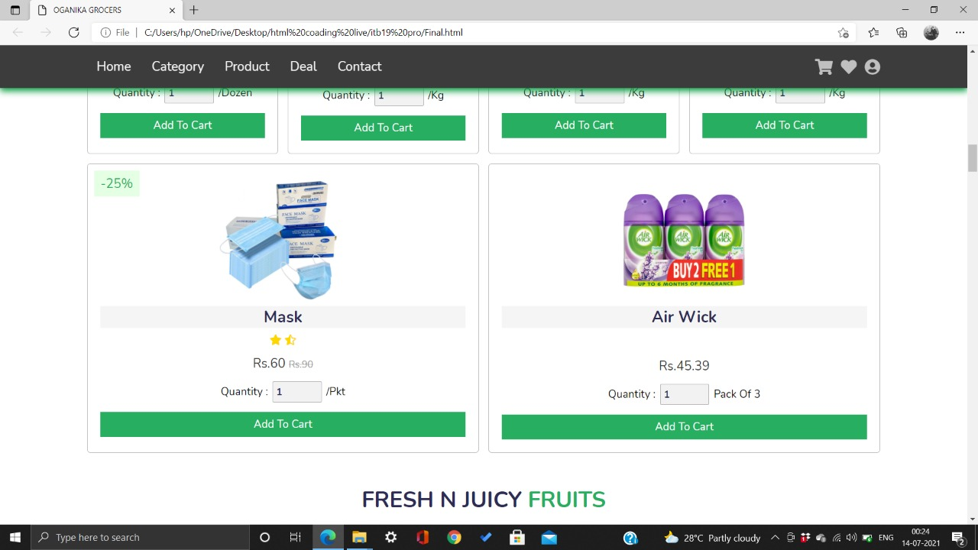
PRODUCT SECTION

Slide 19
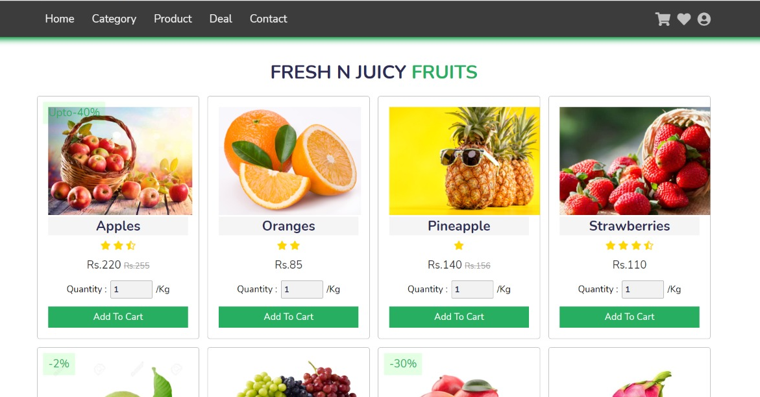
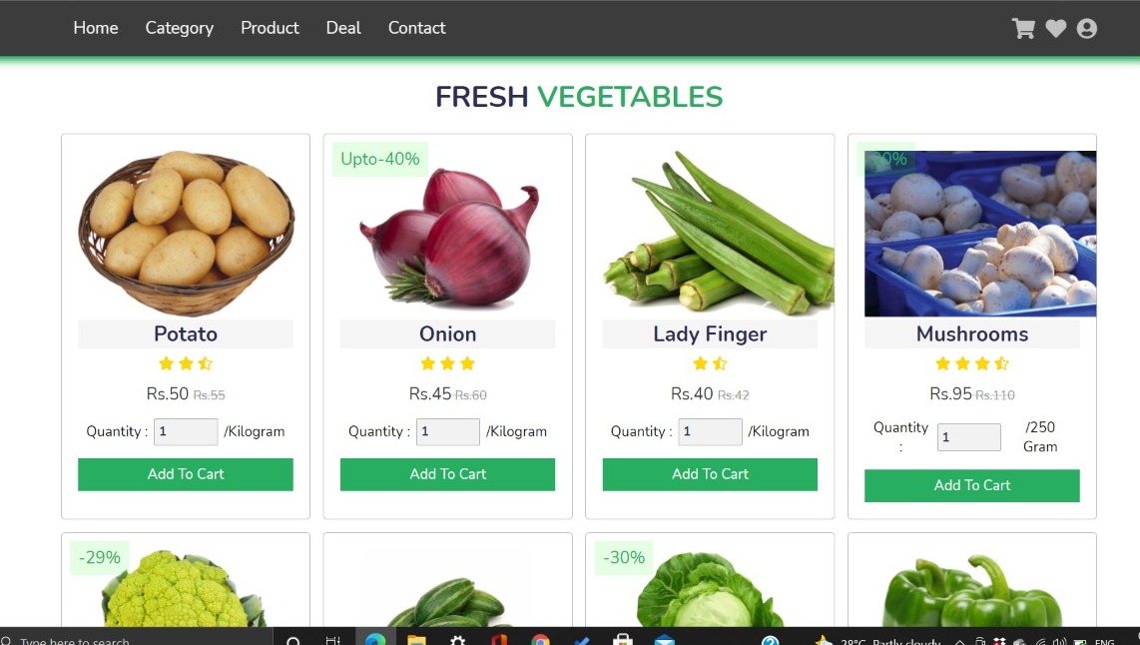

Slide 20
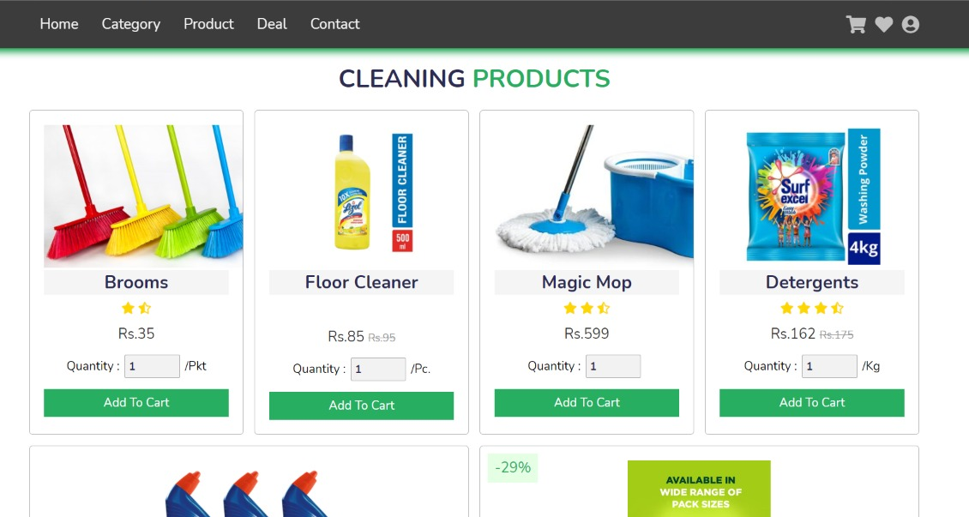
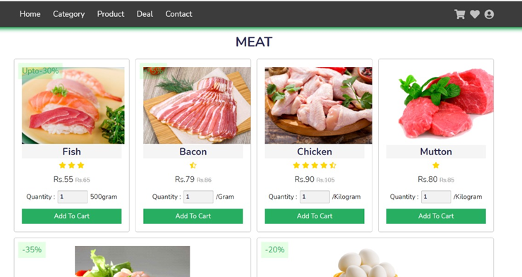
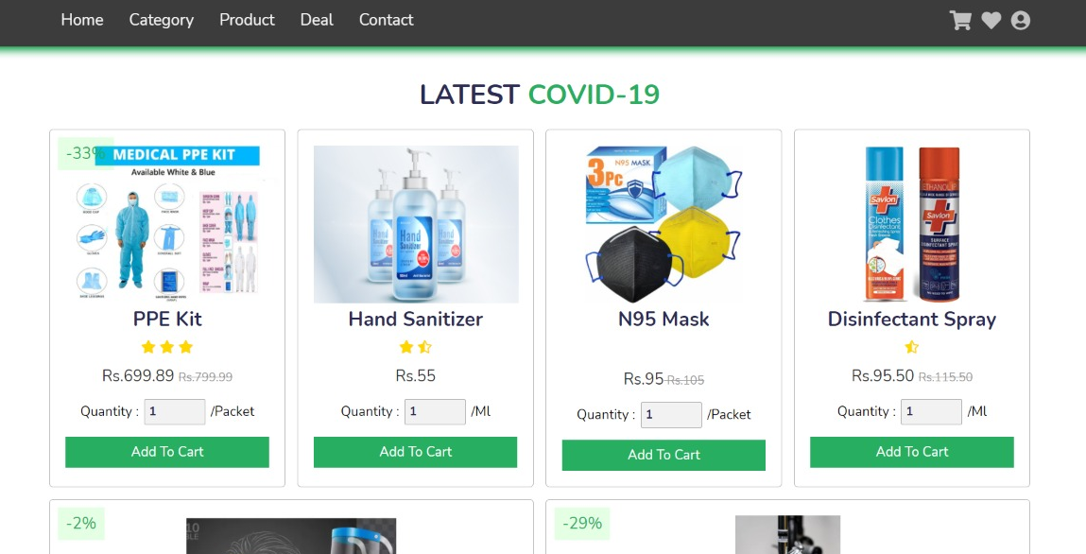
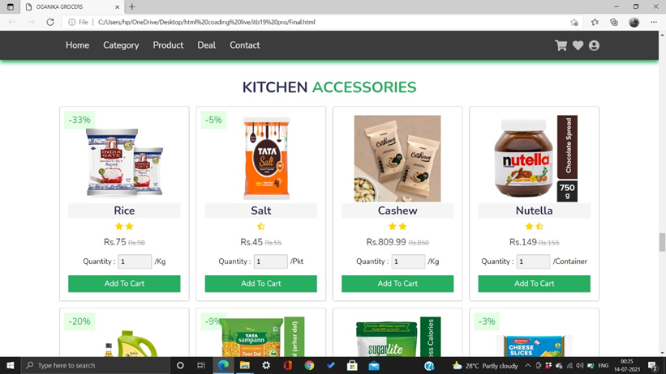

Slide 21
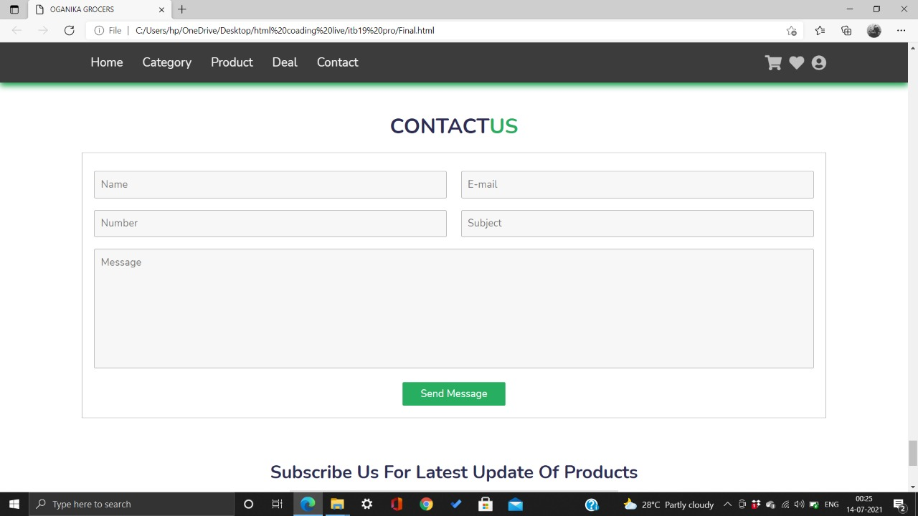
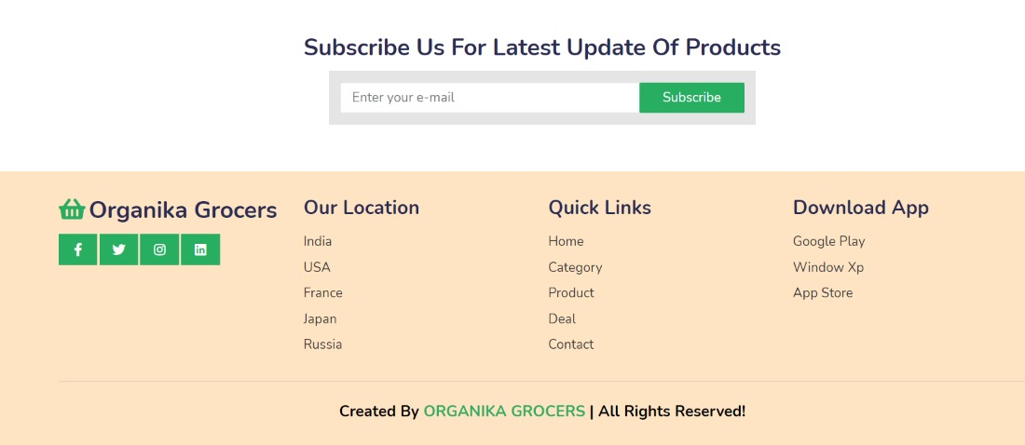
CONTACT US
FOOTER

Slide 22
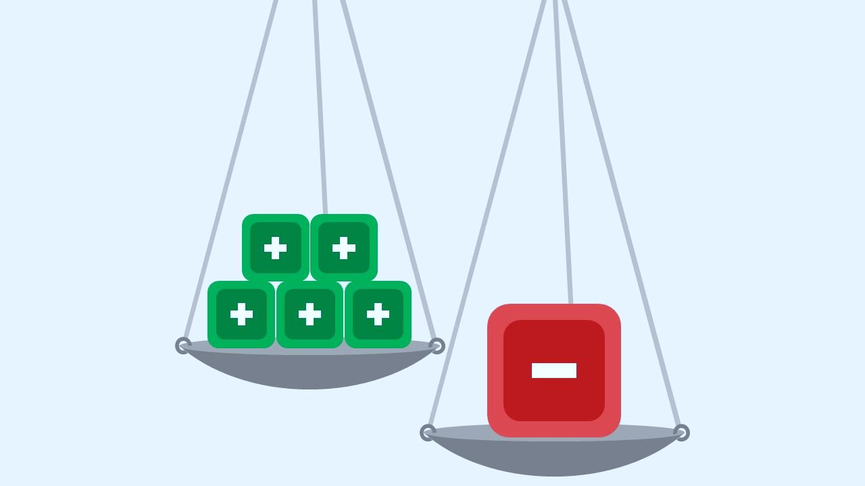

ADVANTAGES
SAVE TIME :-
Whether its 2pm or 4am online shopping allows you
to browse from where you want whenever your want.
Avoid multiple Trips.
SAVE MONEY :-
Cut Fuel and Parking Cost.
Free Home Delivery at certain offers.
Better for Environment.
Keep track on how much you spending and lighten your paper trail too.

Slide 23
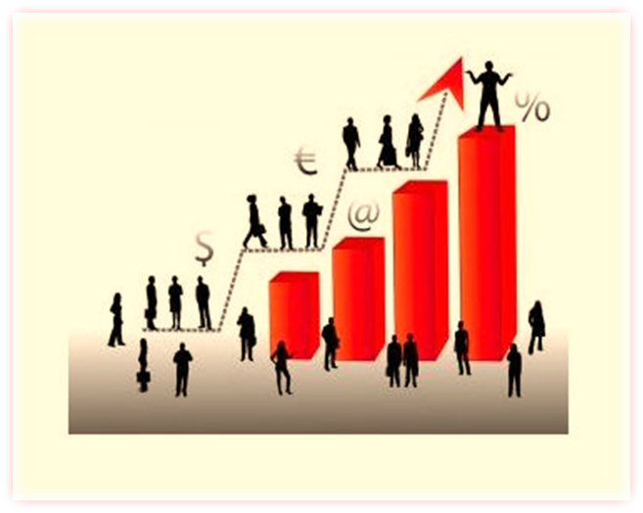
SCOPE
The Online Grocery market is to increase the profit margin of business owners. The market will be made up various parts which include :-
PRODUCT CATALOG
PRODUCT ATTRIBUTES
REPORTING & ORDER TRACKING
SECURITY IS VITAL

Slide 24

CONCLUSION
The Presentation provides a conclusion on how the project has been directed. What has been achieved during this project and also my personal thoughts in developing the website.
My personal thoughts in how present development may shape the future of online grocery shopping. The primary aim of this project has been met.

Slide 25


